Slide 1

Crude Oil Price Prediction
Group : 3
ANUP
SAHANA

Slide 2


Objective
Oil is a commodity notorious for being able to go in the complete opposite direction after a single market event.
This is because the fundamentals of oil price are rarely based on real-time data, instead, it is driven by externalities making our attempt to forecast it even more challenging.
As the economy will be highly affected by oil prices. Our model will help to understand the pattern in prices to help the customers and businesses to make smart decisions.

Slide 3
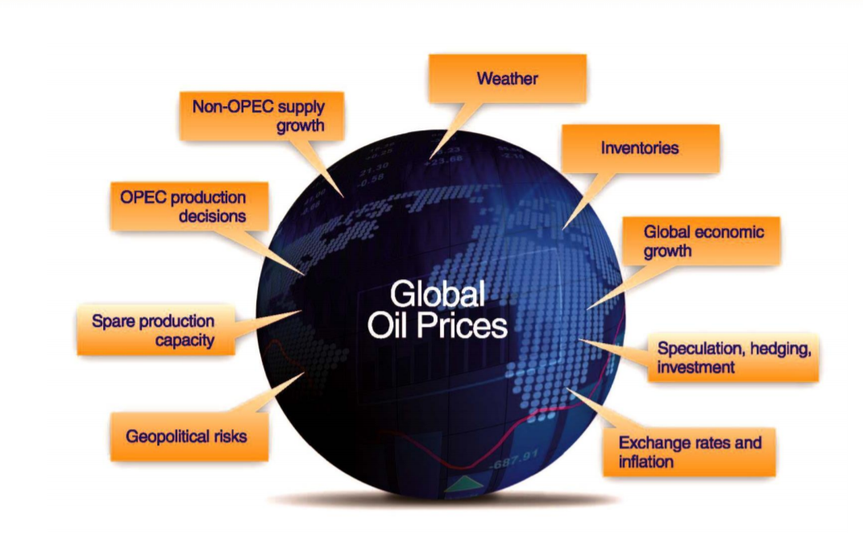
Factors Affect the oil price
Many factors affect the price of oil, but in the end it comes down to supply and demand

Slide 4
Project Architecture / Project Flow
Data Collection
Explore & Visualizations
Data Processing
Partition Series
Model Building
Evaluate & Compare Performance
Deployment

Slide 5
Data Collection

Slide 6
Dataset
Downloaded the oil price dataset from U.S. Energy Information Administration.
Dataset consist of 01st JAN 1986 to 06TH OCT 2023 (37 years) of daily oil price.

Slide 7
Explore & Visualizations

Slide 8
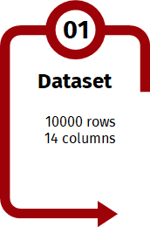
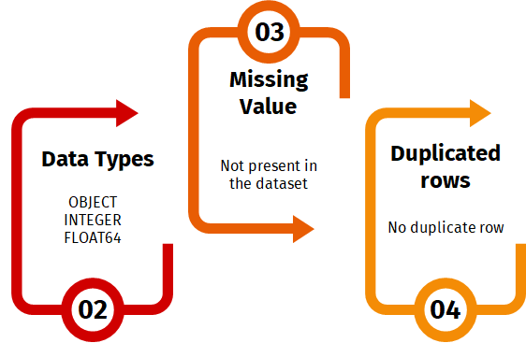
Inferences from Data-Set
1309 Rows
2 Columns
Datetime
Float

Slide 9
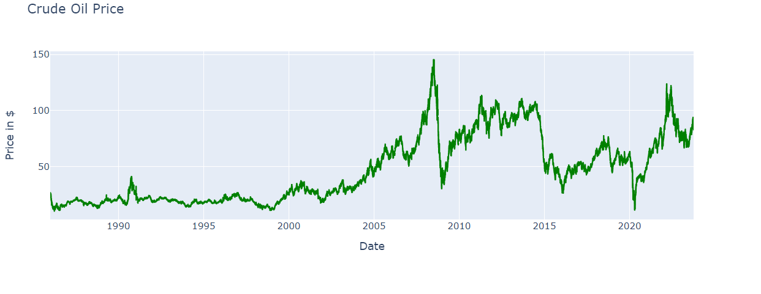
Line Plot
Inferences:
1)We can clearly see that price has increased about 8-10 times over the period of 38 years(1986 - 2023). However an upward trend can be noticed from 1999 to 2023 reflecting rise in world economy and ever-increasing demand and dependency on crude oil.
2)In 1998, the crude oil price hit a record low.From 2003 to 2008 there has been a surge in price reaching it's peak in 2008
4)From 2008 to 2009, the prices crashed because of global financial crisis.From 2009 to 2014 we can see that price increased gradually as the economy recovered.

Slide 10
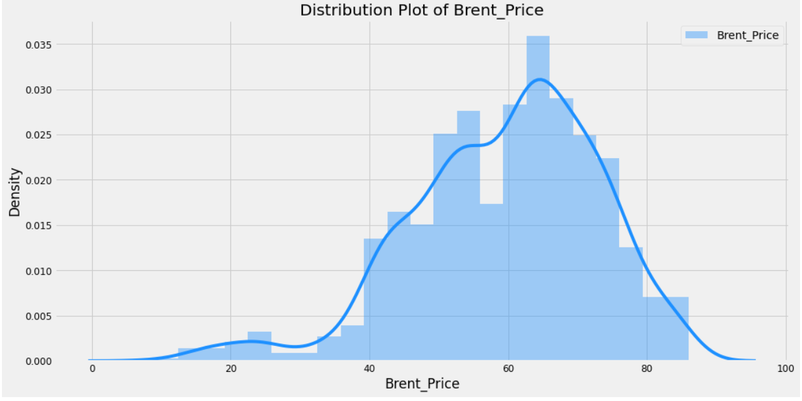
Histogram and Distribution Plot
Inferences :
Most frequent values of Brent are in the range of 61 to 69.
The Brent oil price values from 0 to 35 are less frequent.
It show the data doesn't follow Normal Distribution.
Left skewed data

Slide 11
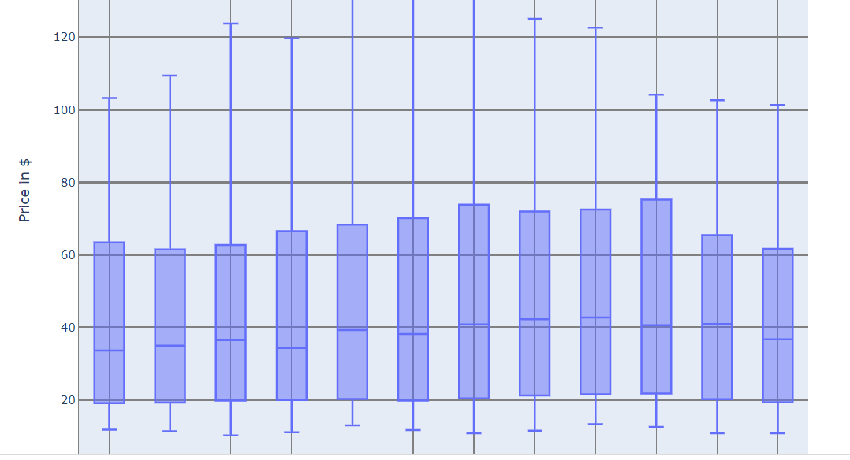
Box Plot Year Wise
The price of crude oil shows some seasonal patterns, with some months having higher or lower prices than others. For example, the months of July and August tend to have higher prices, while the months of December and January tend to have lower prices.
Notes:
-INFERENCES-
In the above diagram we can see the year 2020 has outliers it was due to the pandemic situation.
but we can also see some of the outliers in the year 2018 ,
The impact of higher oil prices on global growth will depend on two elements: i) the factors responsible for the movement (supply, demand, or others)
Actually 2017(june) to 2018 (oct) was the boom year for oil market.
Due the oil market was in a situation in which supply persistently exceeded demand
As the months passed the price of oil dropped in November 2018 because of a number of factors, including
"rising petro-nations' oil production,
the U.S. shale oil boom,
and swelling in North American oil inventories," according to Market Watch.
After sudden decrease in oil prices at continuous interval may have cause some outliers.
—-----------------------------------------------------------------------------------------------------------------------------------------------------------------------------------------------------------------
-ON THIS BASIS I HAVE TAKEN THE INFERENCES-
For 2020 ( pandemic situation reason)
as rising Covid cases prompted fears of a demand slowdown. West Texas Intermediate crude futures declined more than 4% at one point to trade as low as $65.15, a level not seen since May. The contract recovered some of those losses during afternoon trading and ultimately settled 2.64% lower at $66.48 per barrel. International benchmark Brent crude settled at $69.04 per barrel for a loss of 2.35%, after hitting a low of $67.60.^{[153]} The biggest challenge for oil markets remains the uncertainty around COVID as the ‘delta variant’ has made for the highest daily case counts since early 2021,” Bank of America said.
For 2018 ( rise and then why falling)
The production capacity in Venezuela had decreased. United States sanctions against Iran, OPEC's third-biggest oil producer, were set to be restored and tightened in November.^{[85]}
The price of oil dropped in November 2018 because of a number of factors, including "rising petro-nations’ oil production, the U.S. shale oil boom, and swelling North American oil inventories," according to Market Watch.^{[86]}
The 1 November 2018 U.S. Energy Information Administration (EIA) report announced that the US had become the "leading crude oil producer in the world" when it hit a production level of 11.3 million barrels per day (bpd) in August 2018, mainly because of its shale oil production.^{[87]} US exports of petroleum—crude oil and products—exceeded imports in September and October 2019, "for the first time on record, based on monthly values since 1973."^{[6]}
When the price of Brent oil dropped rapidly in November 2018 to $58.71,^{[88]} more than 30% from its peak,^{[89]}—the biggest 30-day drop since 2008—factors included increased oil production in Russia, some OPEC countries and the United States, which deepened global over supply, were factors in the crash.^{[88]}

Slide 12
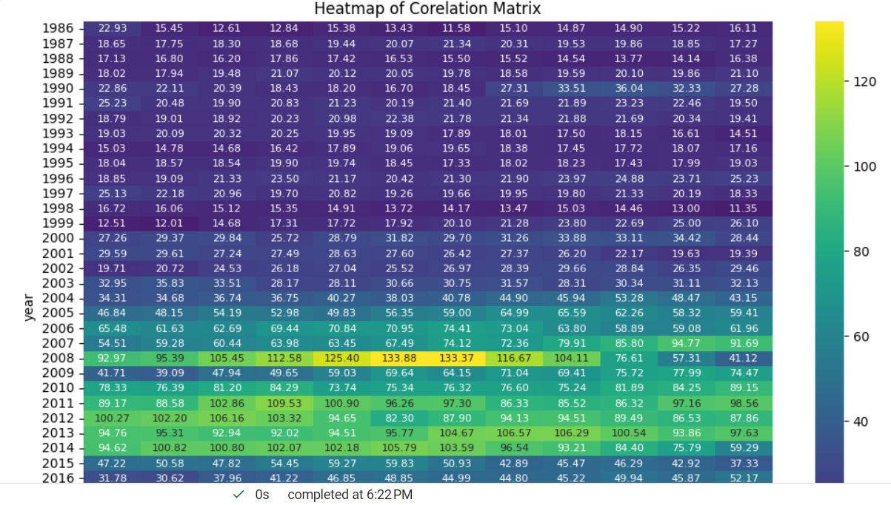
Heat Map
1) It can be clearly seen that crude oil price increases as we approach winter season. [NOV - FEB] It might be because of the weather conditions.
2) The highest prices can be seen in 2008 and 2011.
3) The lowest prices can be seen in 1986, 1998,2009 and 2020
Notes:
The above heat map depicts overall story of Brent crude oil prices from Oct 2016 to Nov 2021. This map has mean values of per barrel price in USD of Brent crude oil of each month in each year. On Y axis we have Year and on X axis we have month. In addition, each cell is filled with average price of Crude oil.
It is evident that this dataset is having data from Oct 2016 to Nov 2021. As in map, the year 2016 has some months containing values as 0 and in year 2021 Dec column shows as value 0 because we do not have data for these months in our dataset.
The darker the colour the lesser the value and vice versa, lightest the colour the highest the value.
This heatmap shows that the average price of crude oil per barrel was high in Oct 2018 with average value as 81.032 and due to pandemic and amid global crisis these prices shows a steep downfall in Apr 2020 to as low as 18.37. Moreover, the all time high prices can be seen in recent months post epidemic in the month of Oct 2021 as high as 83.53 with continuation of rally in following month of Nov 2021 with price as 82.41. Finally, we can say that the prices are getting normal and touching highest which is a good symbol that now we have a stable demand of crude oil.

Slide 13
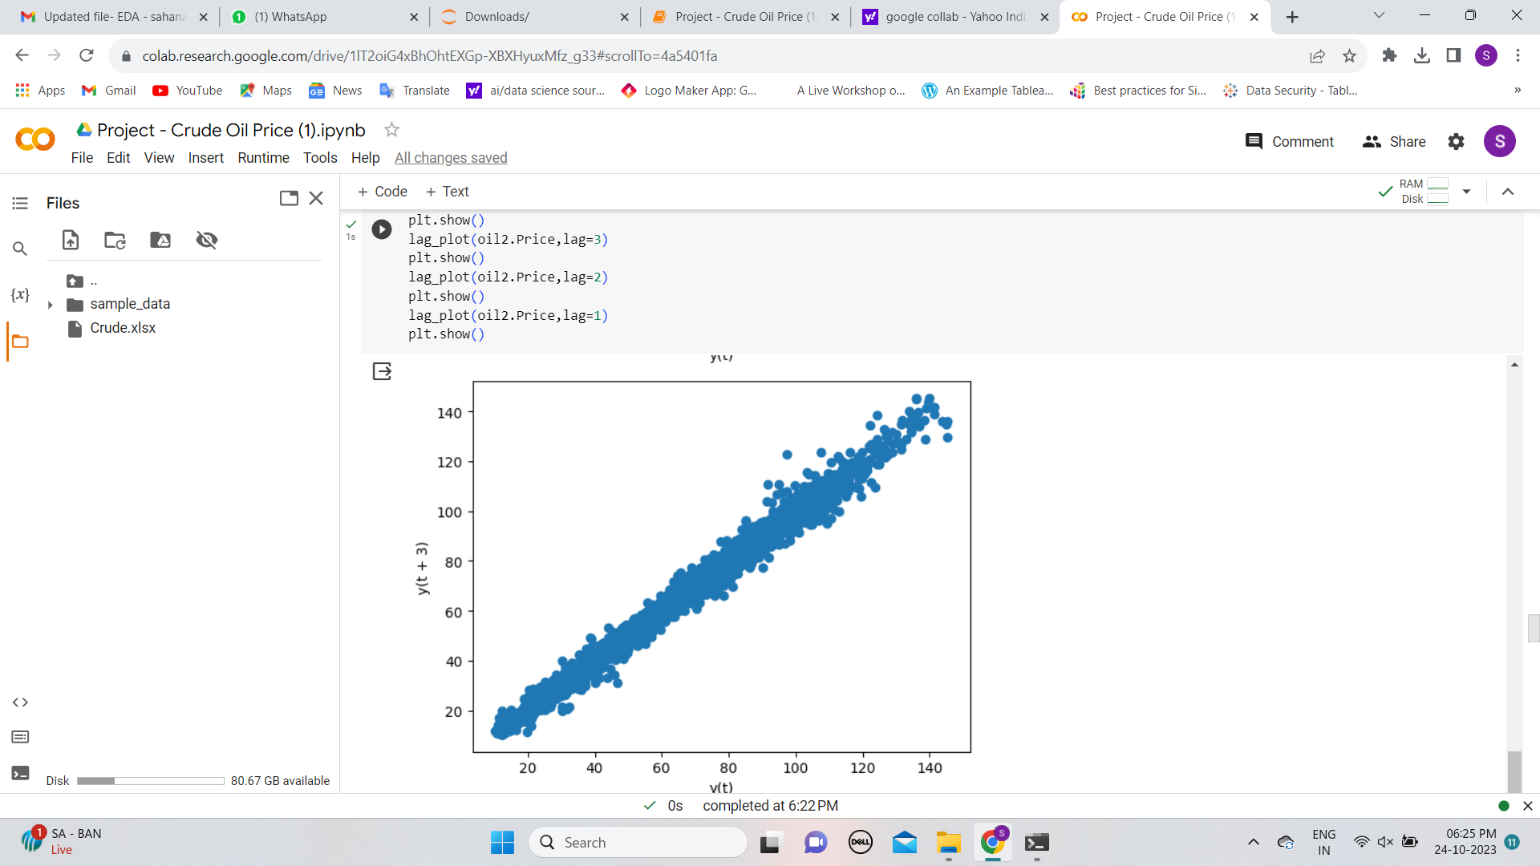
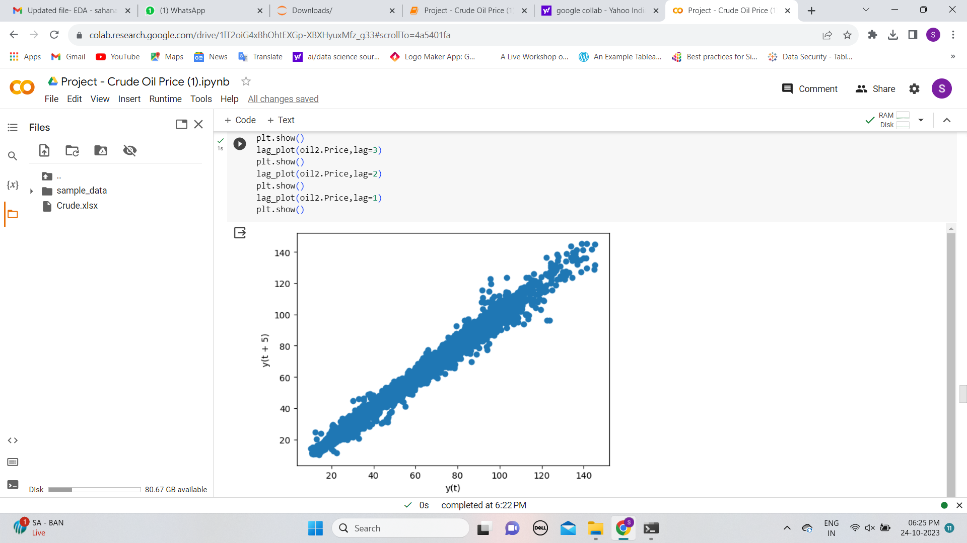
Lag Scatter Plot
Notes:
A lag plot is a special type of scatter plot in which the X-axis represents the dataset with some time units behind or ahead as compared to the Y-axis. The difference between these time units is called lag or lagged and it is represented by k.

Slide 14
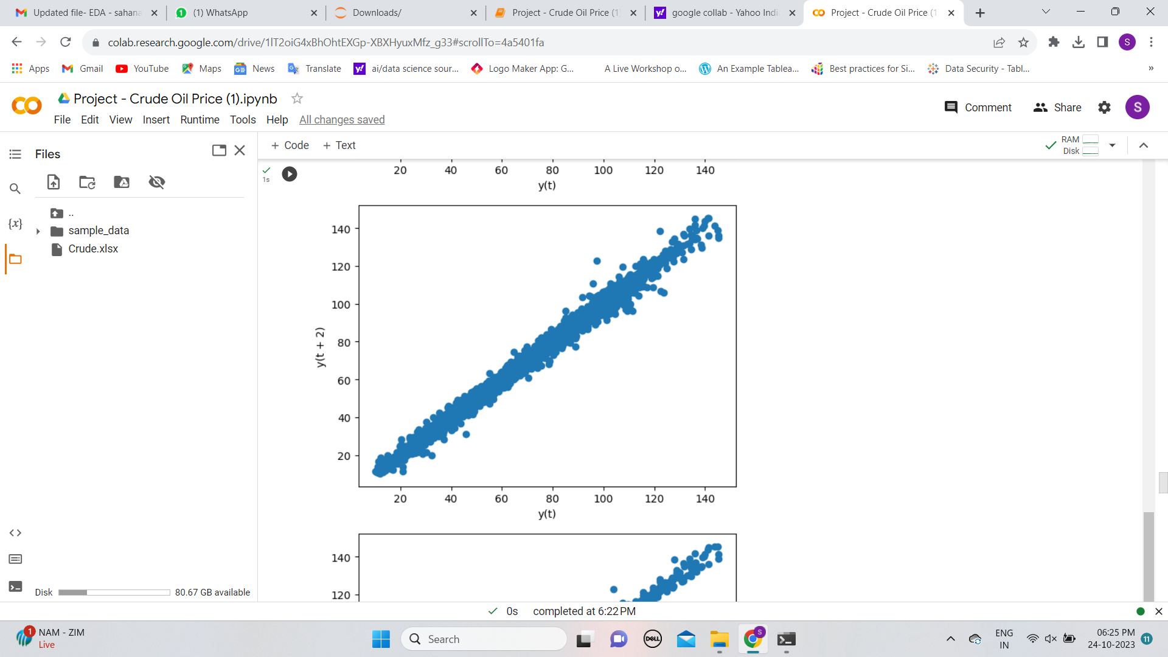
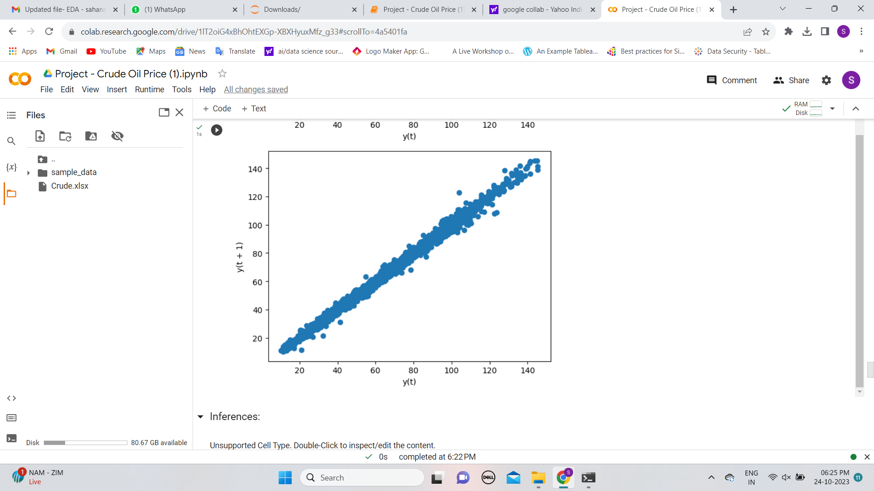

Slide 15
1)We can say that the data is homogeneous and consistent. 2)There are no outliers and we can also say that data is not random. 3)There is a very strong co-relation between both variables.

Slide 16
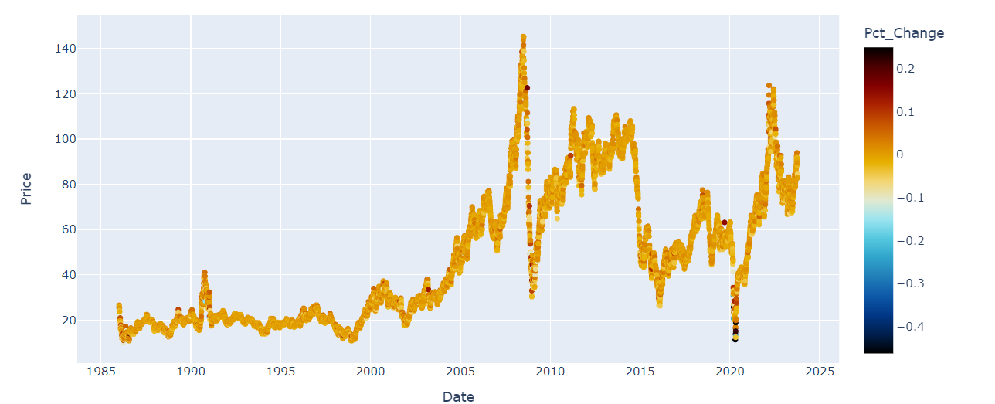
Line Plot of Price & Percentage Change: We can use the above interactive plot to see daily pct_changes.

Slide 17
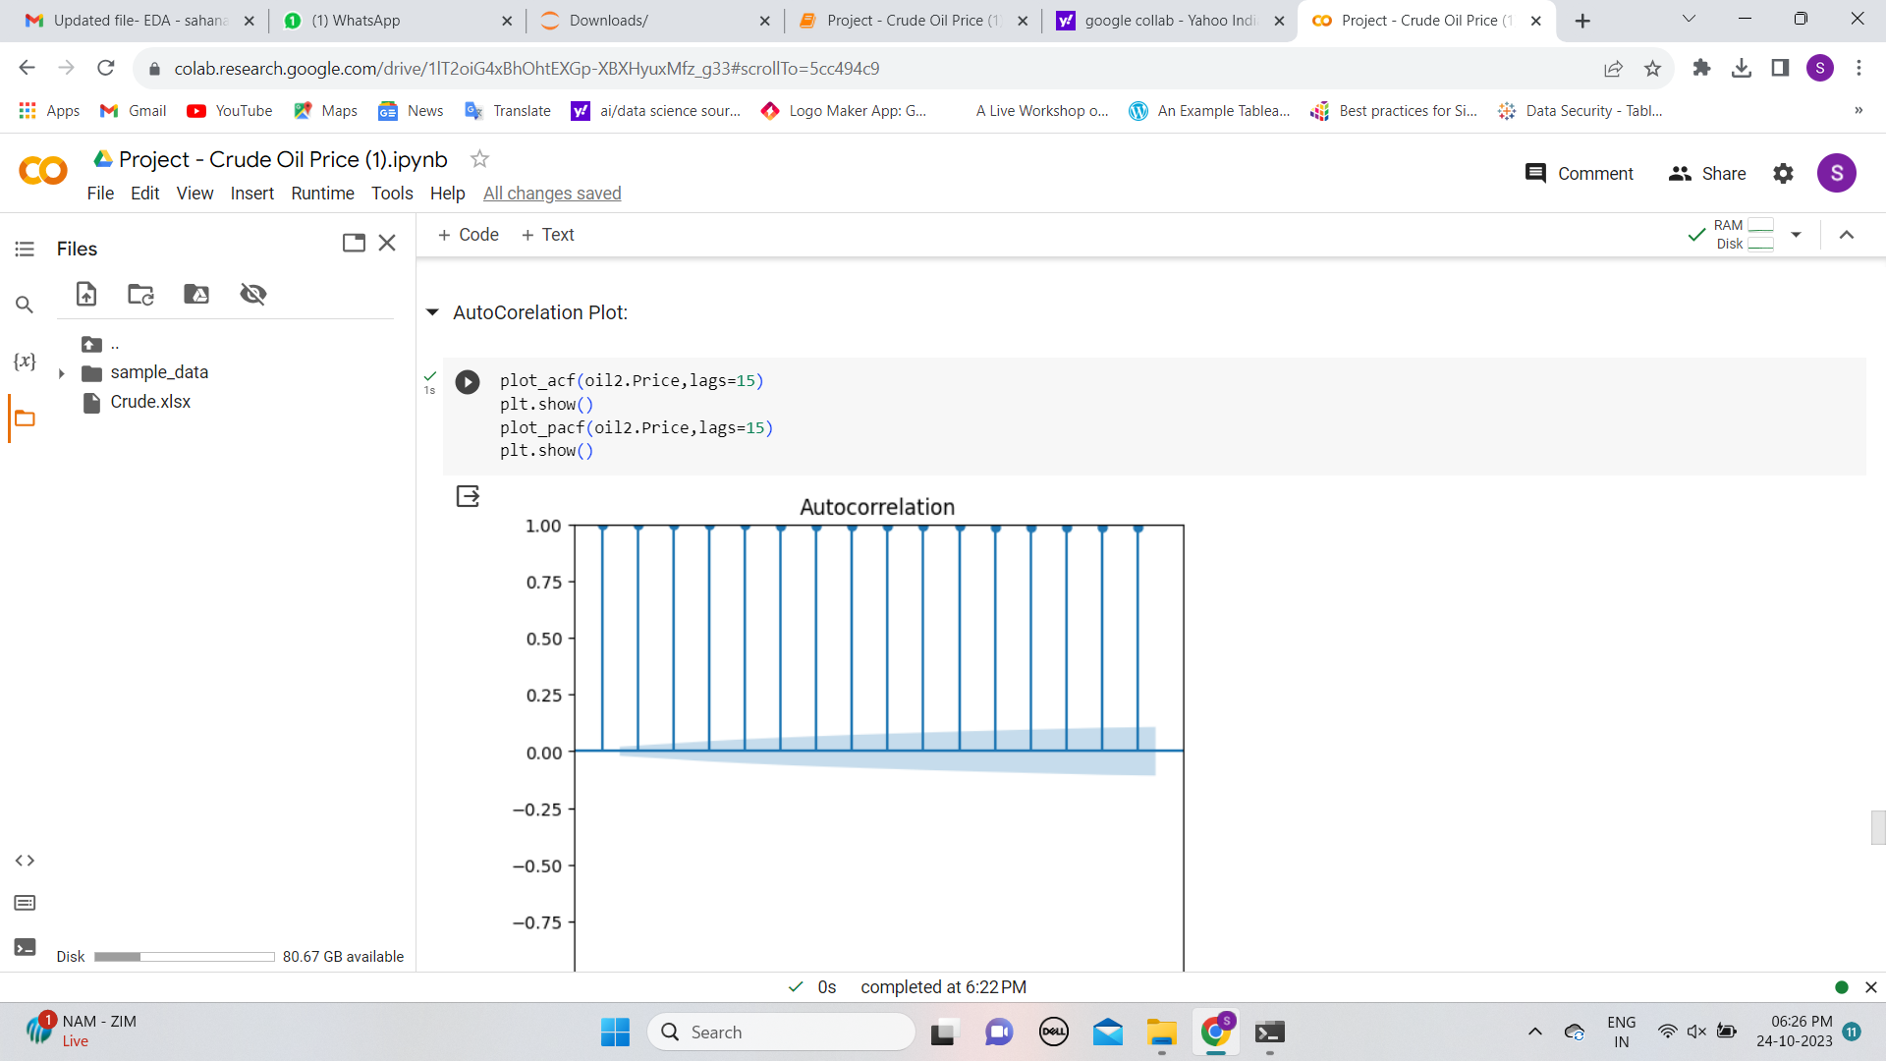
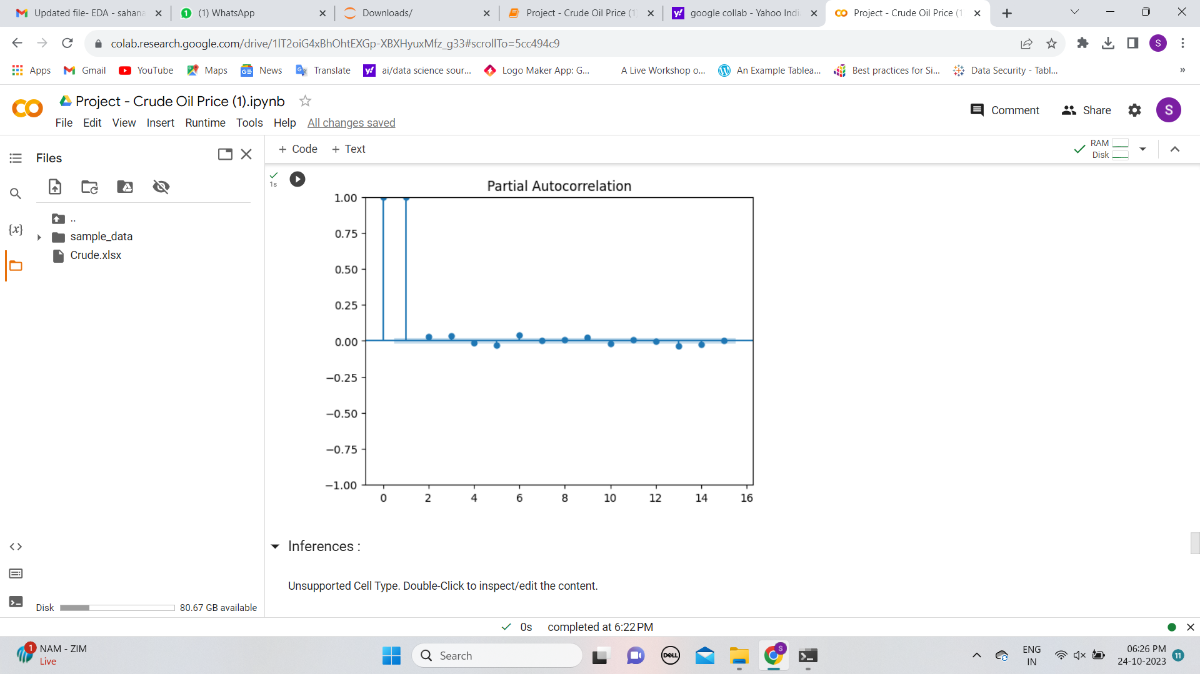
Autocorrelation
1) We can say that data is less volatile as 1st, 2nd, 3rd and 4th lag has value close to 1
2) We can say that the data has non-stationary behavior as we can see a gradual decline in autocorrelation coefficients.

Slide 18
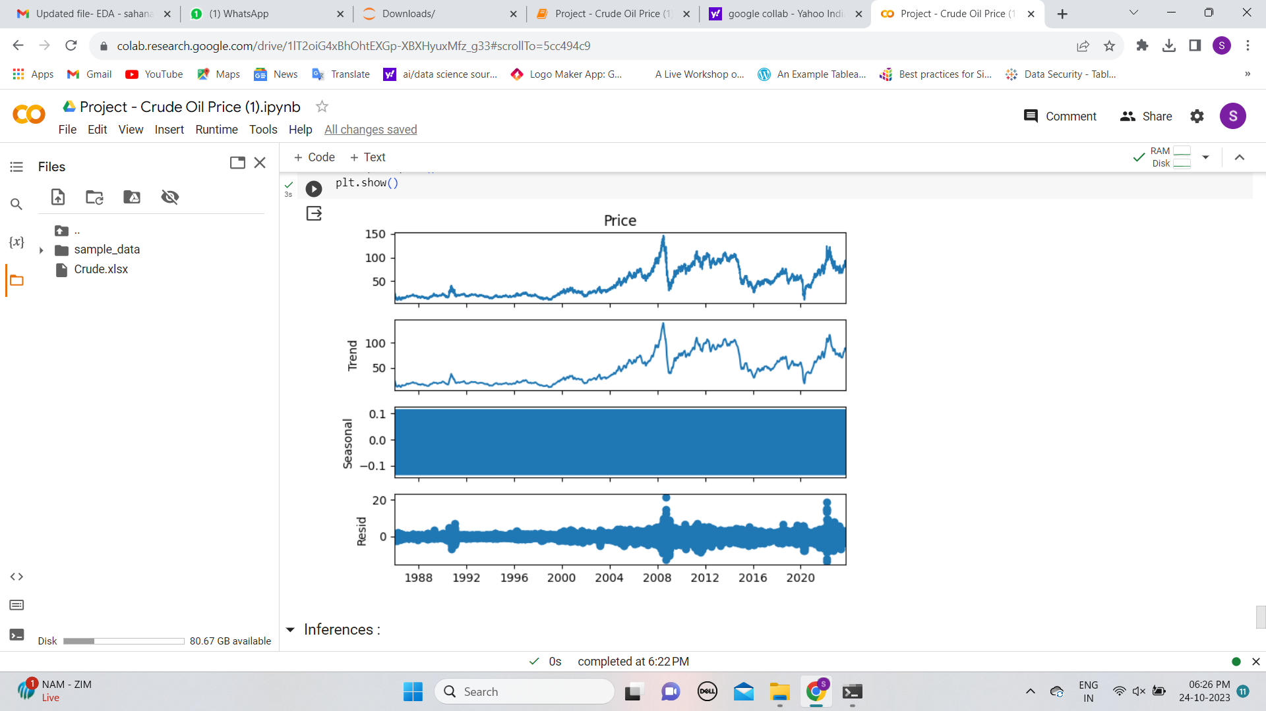
Decomposition plot
1) We can notice a long term upward trend. 2) Seasonality component is absent.

Slide 19
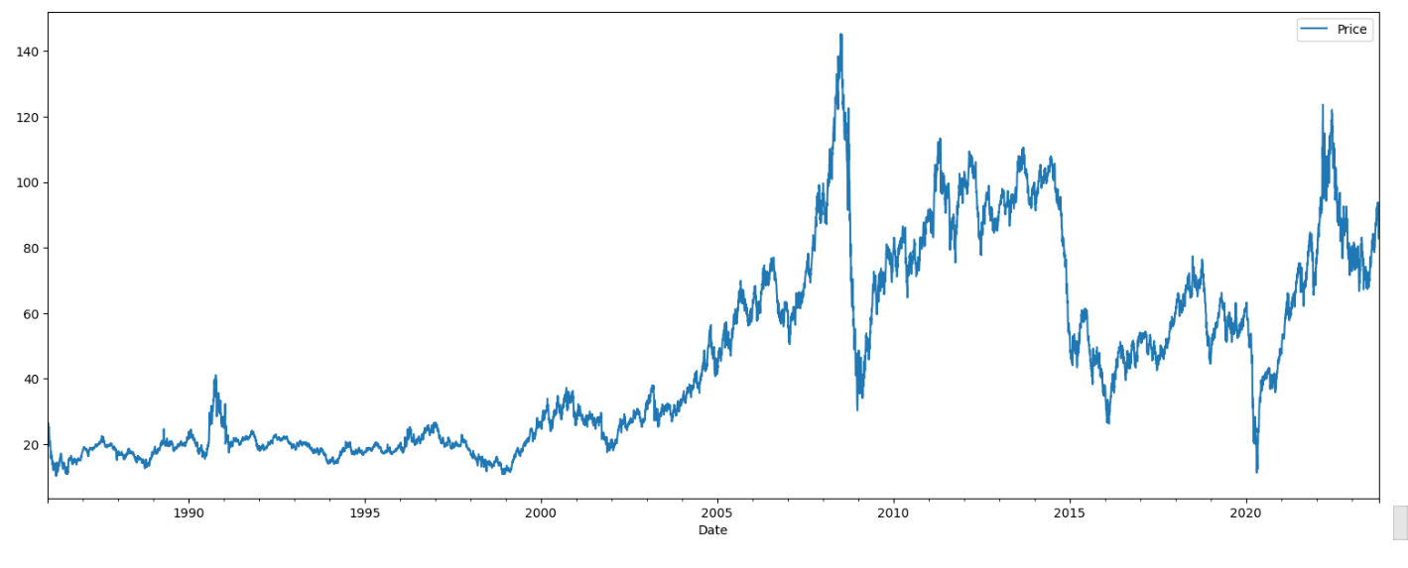

Slide 20
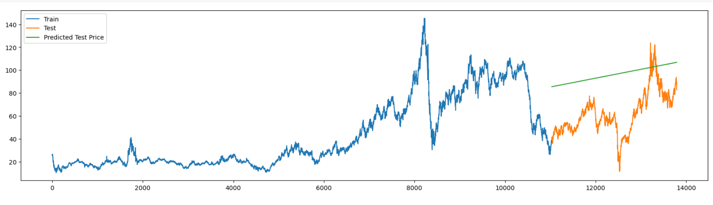
LINEAR MODEL

Slide 21
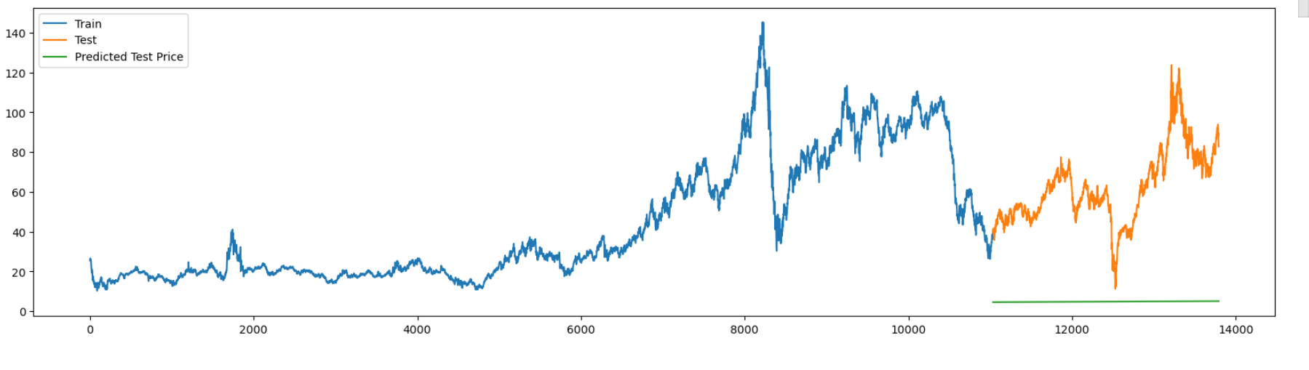
Exponential Model:

Slide 22
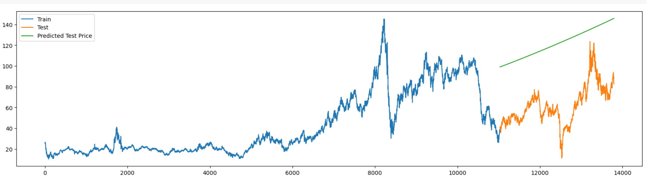
QUADRATIC MODEL

Slide 23
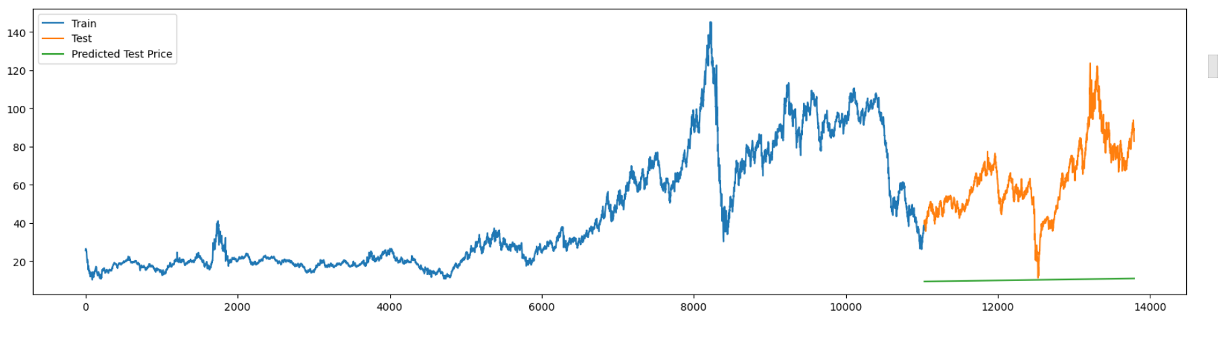
SQRT MODEL

Slide 24
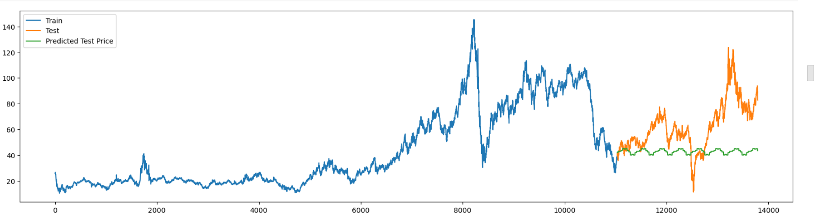
Additive Seasonality Model

Slide 25
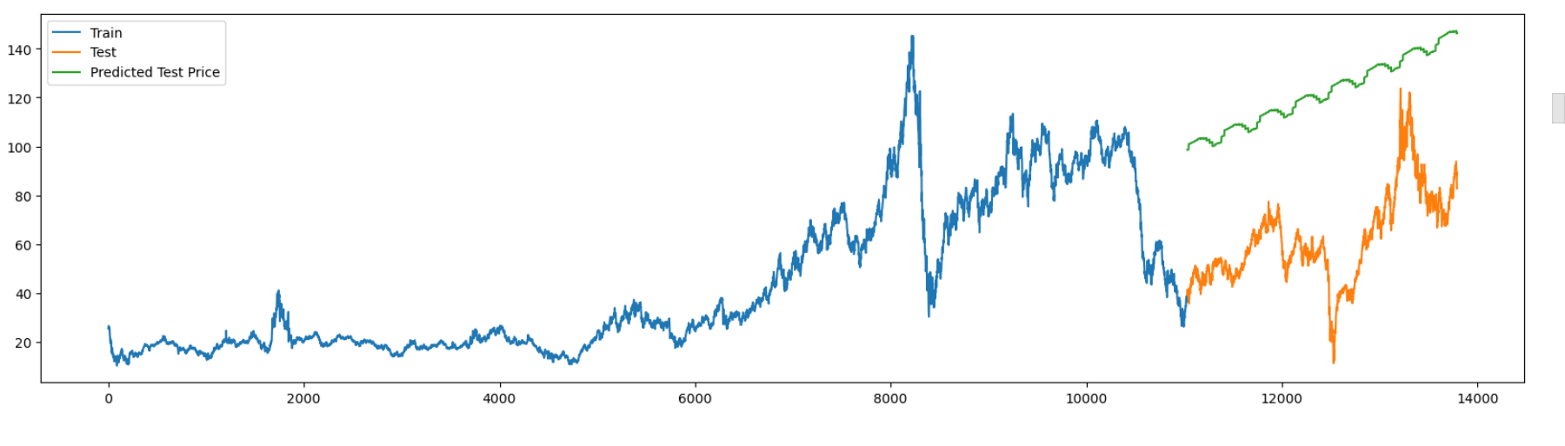
Additive Seasonality Quadratic Model

Slide 26
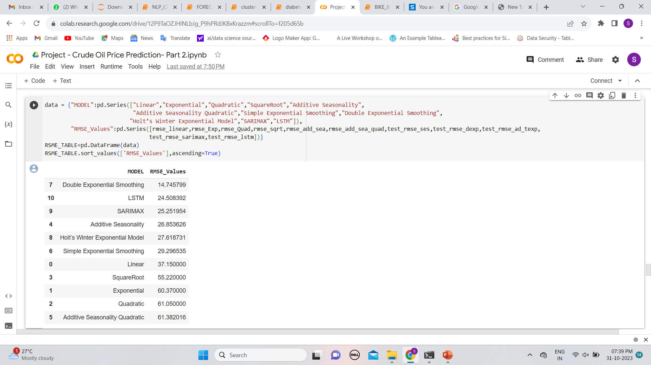
Comparing the results

Slide 27
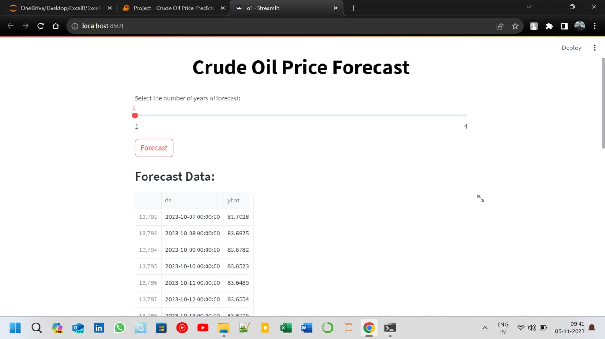
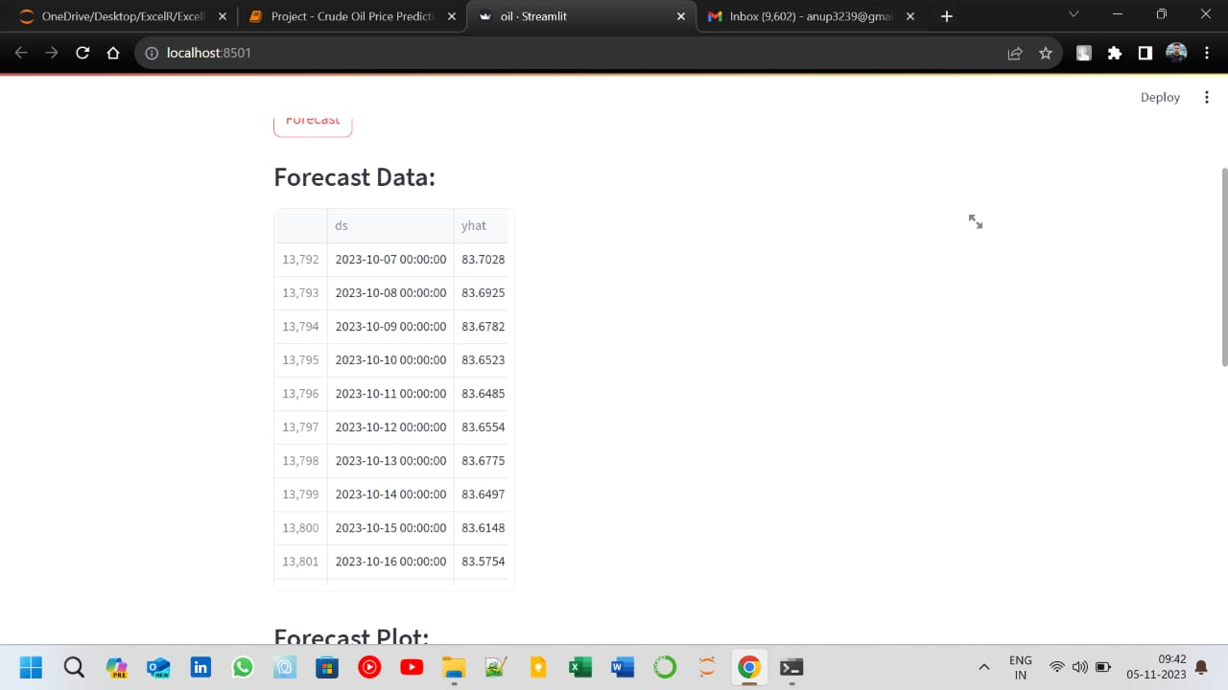
MODEL DEPLOYMENT (STREAMLIT)

Slide 28
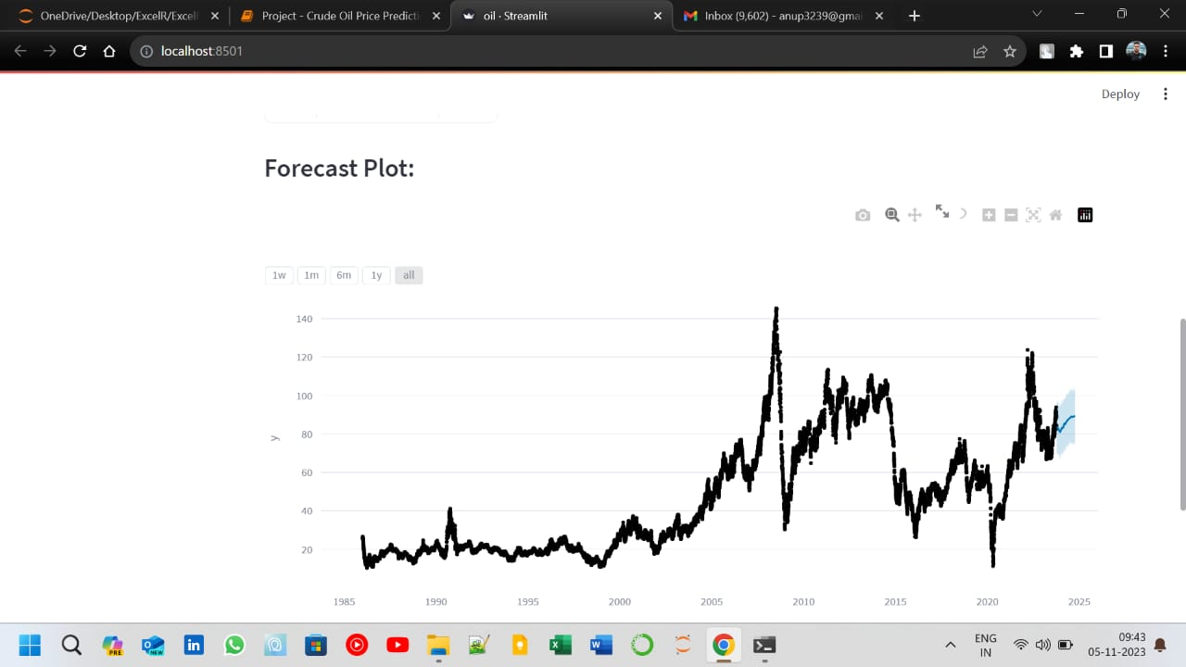

Slide 29
CHALLENGES FACED
Webscrapping
Eliminating Outlier
CHALLENGES
Model Building
Increasing Model accuracy

Slide 30
Thank You

